Slide 1
Determinates and outcomes of Brand Hate for Travel Apps
Marc Fetscherin, Ph.D.
Gelbman Family Chair of International Business
Professor of Marketing
Rollins College, USA

Slide 2
Background
Smart phone usage is increasing
6 billion users globally
6 million apps available
218 billion apps download till 2020
Travel app Engagement Benchmark Reports (2021)
3-month retention rate for travel app was 29%, with a churn rate of 71%
Moreover, according to Gupta et al. (2018)
Annual travel App retention rate is 10%, with a churn rate of 90%. Only 15% of travelers use travel apps to plan their trips

Slide 3
Motivation
Dissatisfaction with travel apps lead to why users don't like or hate using them
Brand hate studied mostly physical products, wonder if also applicable to digital products
Extend research by introducing Poor Brand Relationship Quality
Extend research by decomposing nWOM into public and private complaining
Measure Brand Hate by multi-dimensional scale from Zhang and Laroche (2020)
Zhang, C., & Laroche, M. (2020). Brand hate: a multidimensional construct. Journal of Product & Brand Management, 30(3), 392-414.

Slide 4
Brand Hate
Sternberg (2003) → Kucuk's (2008) → Bryson et al. (2013) → Zarantonello et al.’s (2016)→ Hegner et al. (2017) → Fetscherin (2019) → Zhang and Laroche (2020)
Extensively studied in physical context but very limited study in the online context
Since COVID, many brands morphed from brick & mortar to click & mortar
Literature suggested that antecedents of brand hate can be categorized in product related, consumer related and market-company related
Brand outcomes can be categorized based on passive behavior (taking a flight) and active behavior (taking a fight) strategy
Different researchers have identified distinct antecedents and outcomes of brand hate based on their context

Slide 5
Hegner et al., (2017)
Negative Past Experience
Brand Avoidance
Symbolic Incongruity
Negative WOM
Brand Hate
(BH)
Ideological Incompatibility
Brand Retaliation
Hegner, S. M., Fetscherin, M., & Van Delzen, M. (2017). Determinants and outcomes of brand hate. Journal of Product & Brand Management, Volume 26 · Number 1 · 2017 · 13–25

Slide 6
Hypotheses
Antecedents of Brand hate
H1: Symbolic incongruity leads towards travel App hate
H2: Ideological incompatibility leads towards travel App hate
H3: Negative past experience leads towards travel App hate
H4: Poor relationship quality leads towards travel App hate
Outcomes of brand hate
H5: Travel App hate leads towards app avoidance
H6: Travel App hate leads towards patronage reduction
H7: Travel App hate leads towards private complaining
H8: Travel App hate leads towards public complaining

Slide 7
H4: Poor Brand Relationship Quality
Poor relationship quality refers to customers' negative relationship with brands other than its actual performance, symbolic value or ideological incompatibility (Hashim and Kasana 2019)
It is found that a positive relationship of brand and customer increase brand equity and loyalty while a negative relationship increases anxiety and anger in consumers (Lemon, Rust, and Zeithaml, 2001)
Recently Hashim and Kasana (2019) found the significant relationship between poor relationship quality on brand hate in the fast-food industry

Slide 8
H7 & H8 Complaining
Consumers are more interested in sharing their bad experiences than their good experiences, which generate negative WOM (Baumeister et al. 2001)
Literature decompose negative WOM into at least two parts, complaining to family and friends (private complaining) and complaining more publicly or to third party organizations such as consumer agencies, legal institutes, and consumers firms (public complaining) (Fetscherin, 2019)

Slide 9
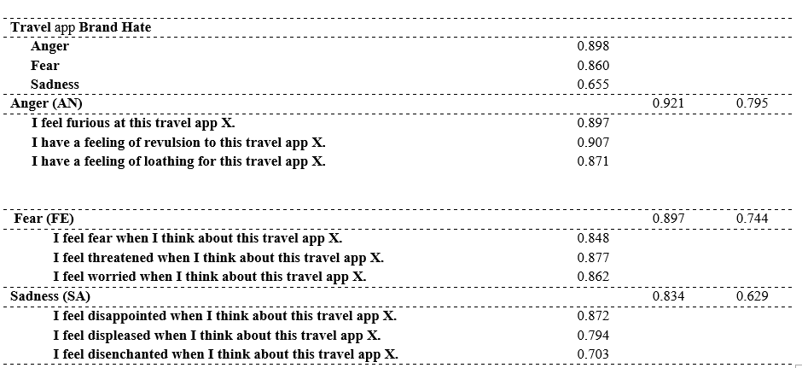
Brand Hate
Use multi-dimensional scale based on anger, fear and sadness

Slide 10
Research Model & Hypotheses
Symbolic Incongruity
Brand Avoidance
H1
H5
Ideological Incompatibility
H2
H6
Private Complaining
Travel App Brand Hate
H3
H7
Indirect Vengeance
Negative Past Experience
Public Complaining
H4
H8
Poor Brand Relationship Quality
Patronage Reduction
Direct Vengeance

Slide 11
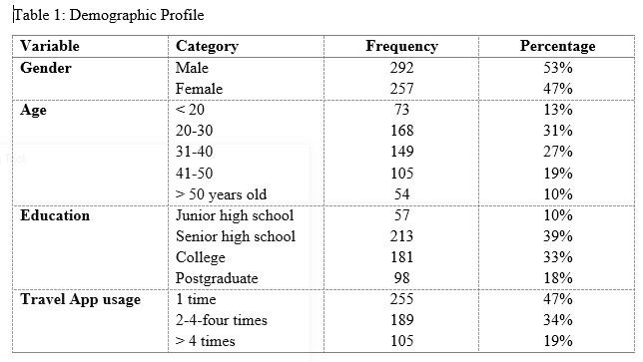
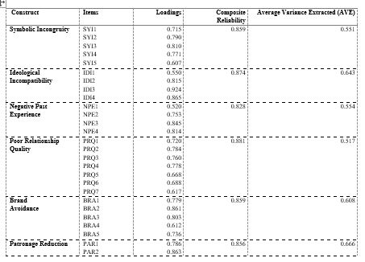
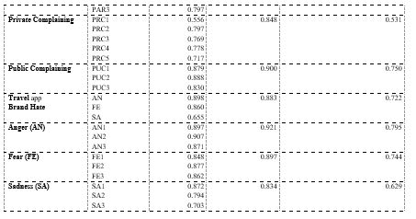
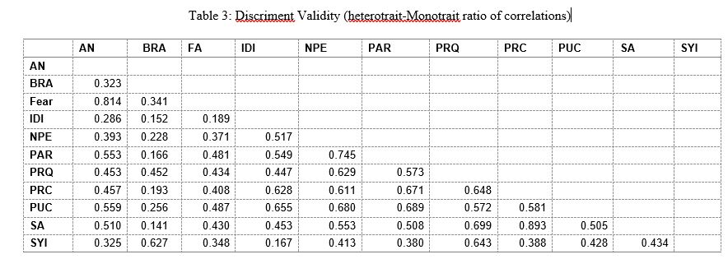
Method
Purposive (non-probability) sampling
Online survey through traveling agencies
549 usable responses
Two stage PLS-SEM Analysis
Measurement Model analysis
Loadings > 0.50
Composite Reliability > 0.70
AVE > 0.5
Correlation of two constructs < 0.9

Slide 12
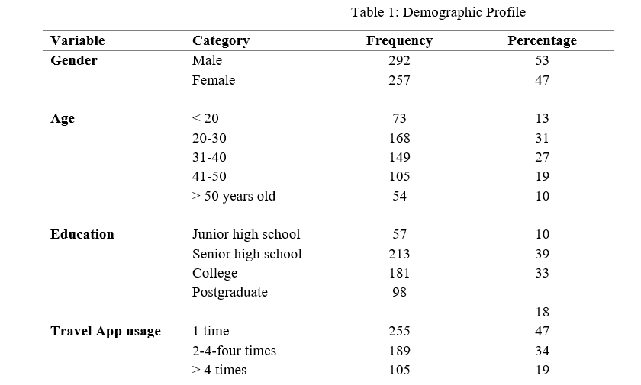
Sample

Slide 13
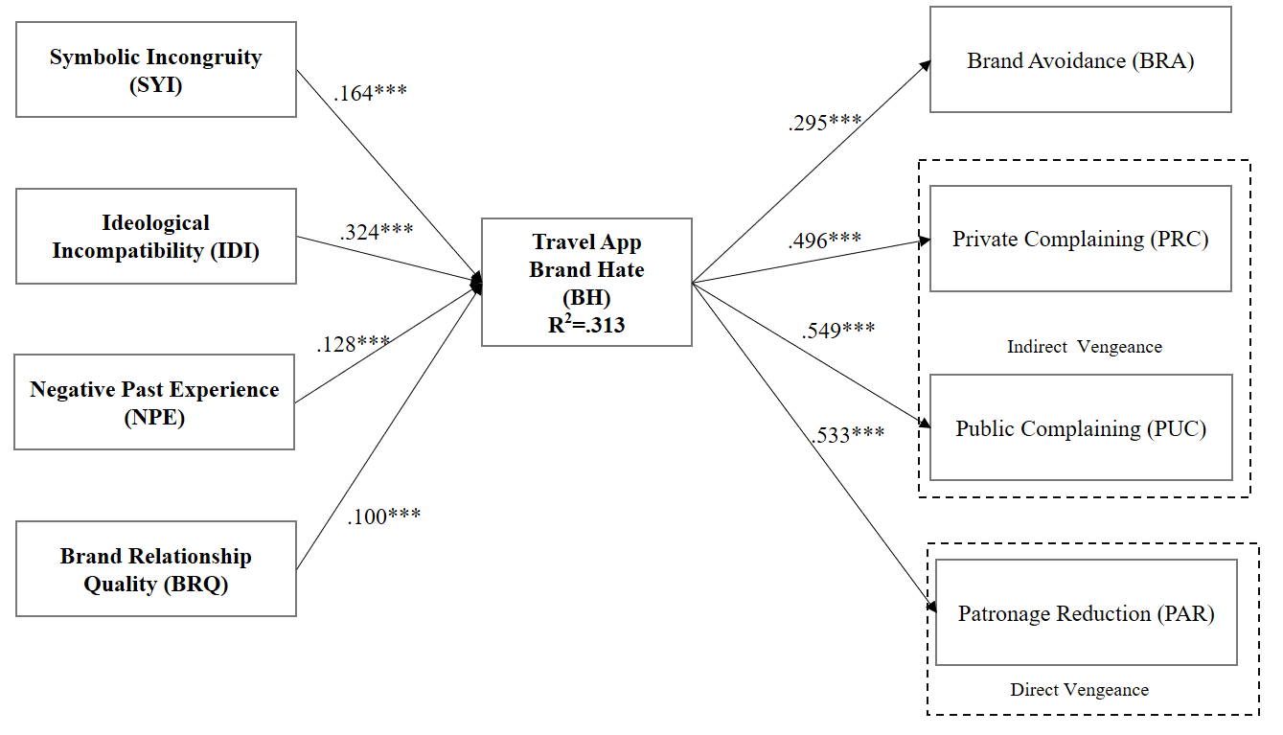
Results
Symbolic Incongruity (SYI)
Brand Avoidance (BRA)
.164***
.295***
Ideological Incompatibility (IDI)
.324***
.496***
Private Complaining (PRC)
Travel App Brand Hate
R2=.313
.128***
.549***
Indirect Vengeance
Negative Past Experience (NPE)
Public Complaining (PUC)
.100***
.533***
Poor Brand Relationship Quality (BRQ)
Patronage Reduction (PAR)
Direct Vengeance

Slide 14
Results
All determinants lead towards brand hate and it leads to brand avoidance, patronage reduction, private complaining, and public complaining
Among all determinants, ideological incompatibility has highest impact on consumers brand hate for travel apps
It means unethical activities of brand or mismatch in ideology of the consumers with brand travel apps can lead to brand hate
While brand relationship quality has lowest impact on brand hate
It is found that consumers are most likely to be involved in attack-like activities, i.e. private complaining and a public complaining if the brand disappoints them badly

Slide 15
Theoretical Contribution
The Study extended and deepened the brand hate model in the Travel app context
The study adopted Zhang & Laroche (2020) multidimensional brand hate construct which was quite limited in the literature
Previous researches mainly focused on the positive emotions, usage intention and adoption of the travel apps but this study extends previous ones by focusing on negative emotion of travel apps

Slide 16
Managerial Implications
Managers have to ensure that the company would not involve any unethical or immoral activity
Travel App developers should provide a set of activities in apps through which consumers consider how this brand is like them
Positive experience and high relationship consistency are needed to prevent negative emotions in customers
The research and development team should focus on two key attributes: App design and efficiency

Slide 17
Limitations and Future Research
The study classified domestic and foreign travelers but didn’t compare them. So future research can compare domestic and foreign travelers
The study only focused on the brand hate for travel apps and ignored the reasons for brand love. So, Future research can test the determinants of brand love for travel apps

Slide 18
Thanks!
Any Question?

Slide 19
Antecedents of Brand Hate
Author (s) (year) | Product-related | Consumer-related | Market/ Company-related | Other
(Krishnamurthy and Kucuk 2009b) | Transactional dissatisfaction (with retailer and quality of service) |  | Market-level dissatisfaction Ideological incompatibility
(Kucuk 2016a) | Transactional (dissatisfaction related to product failure) | Ideological (related to social change) Consumer personality issues | Market-industry (related to irresponsible practices)
(Zarantonello et al. 2016) | Violations of expectations | Taste systems | Corporate wrongdoings
(Hegner, Fetscherin, and Delzen 2017) | Negative past experience | Symbolic incongruity | Ideological incompatibility
(Kucuk 2018) | Product or Service failure |  | Corporate social responsibility
(Zarantonello et al. 2018) | Negative past experience | Image incongruence | Corporate wrongdoings
(Hashim and Kasana 2019) | Negative past experience | Symbolic incongruity | Ideological incompatibility | Rumour Poor Relationship Quality

Slide 20
Outcome of Brand Hate
 | Take a flight (passive behavior) | Take a fight (active behavior)
Author(s) year | Brand Avoidance/Switching | Private complaining | Public Complaining
(Kucuk 2016a) |  | Negative word of mouth | Complaining | Consumer boycott
(Zarantonello et al. 2016) | Patronage reduction | Negative word of mouth | Complaining | Protest
(Hegner, Fetscherin, and Delzen 2017) | Brand Avoidance | Negative word of mouth |  | Brand retaliation
(Fetscherin 2019) | Brand Switching | Private Complaining | Public Complaining | Retaliation
(Curina et al. 2019) | Brand Avoidance | Negative word of mouth | Online Complaining
(Zhang and Laroche 2020) | Patronage reduction | Negative WOM | Complaint | Protest
(Curina et al. 2020) | Non-purchase intention | Offline NWOM | Online Complaining
(Bayarassou, Becheur, and Valette-Florence 2020) | Avoidance |  |  | Revenge

Slide 21
Results and Analysis
Hypotheses | Beta Values | STD | T Statistics | VIF | P Values | Supported | R² | F² | Q²
H1: SYI → BH | 0.164 | 0.058 | 2.860 | 1.560 | 0.002 | ✓ | 0313 | 0.027 | 0.142
H2: IDI → BH | 0.324 | 0.064 | 5.067 | 1.303 | 0.000 | ✓ |  | 0.080
H3: NPE → BH | 0.128 | 0.063 | 2.032 | 1.456 | 0.021 | ✓ |  | 0.015
H4: BRQ → BH | 0.100 | 0.054 | 1.856 | 1.894 | 0.032 | ✓ |  | 0.011
H5: BH → BRA | 0.295 | 0.048 | 6.150 | 1.000 | 0.000 | ✓ |  | 0.095
H6: BH → PAR | 0.496 | 0.041 | 11.993 | 1.000 | 0.000 | ✓ |  | 0.396
H7: BH → PRC | 0.549 | 0.043 | 12.709 | 1.000 | 0.000 | ✓ |  | 0.431
H8: BH → PUC | 0.533 | 0.045 | 11.911 | 1.000 | 0.000 | ✓ |  | 0.396

